Slide 1
Czeski Cieszyn

Slide 2
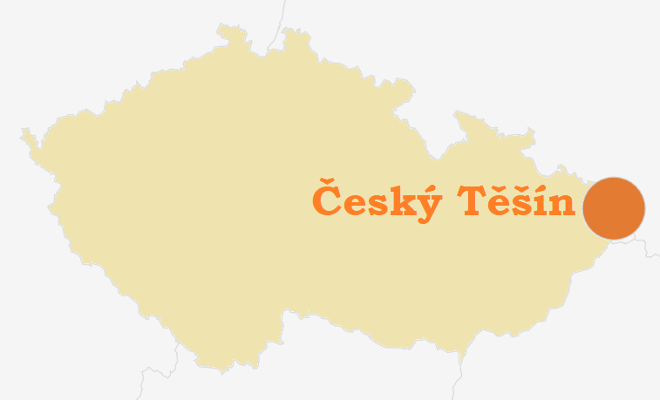
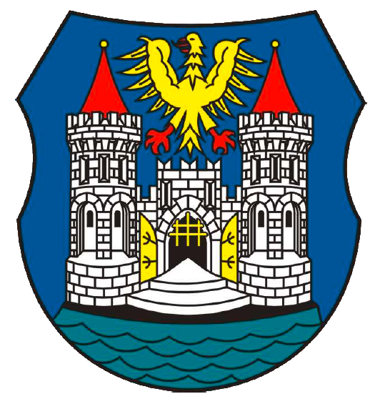
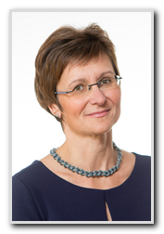
General information
Population - 23 000
Mayor - Gabriela Hřebáčková
History - Český Těšín was created as a result of a two years long misunderstaning between Czechoslovakia and Poland .

Slide 3
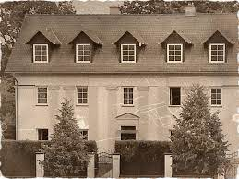
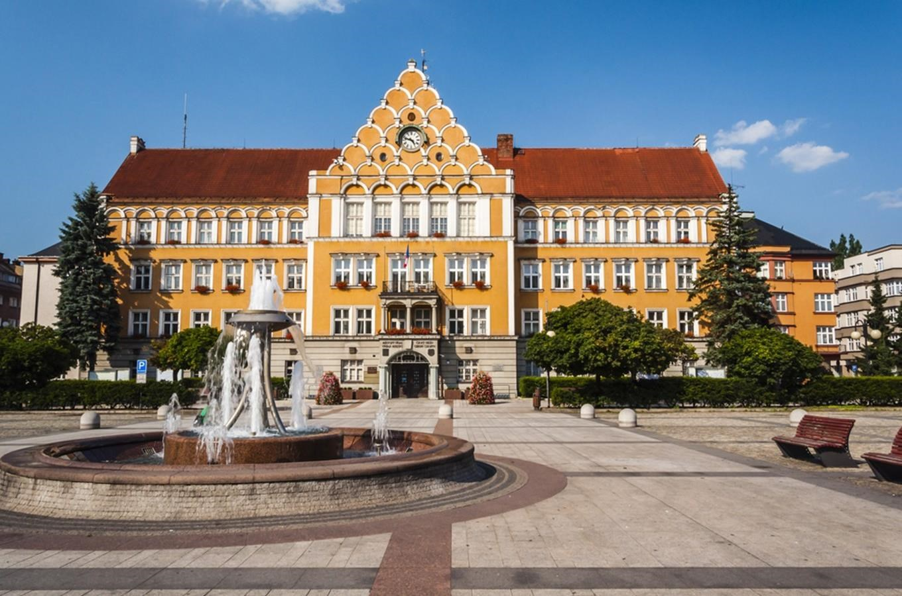
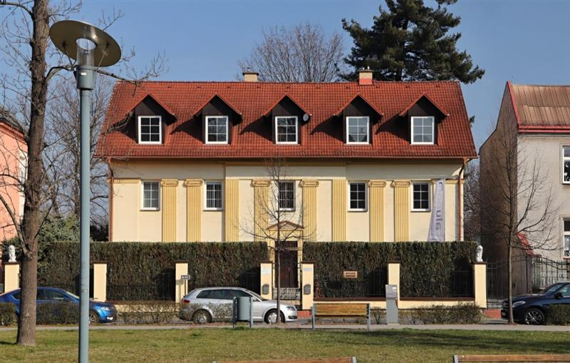
Interesting places
The oldest house
City Hall

Slide 4
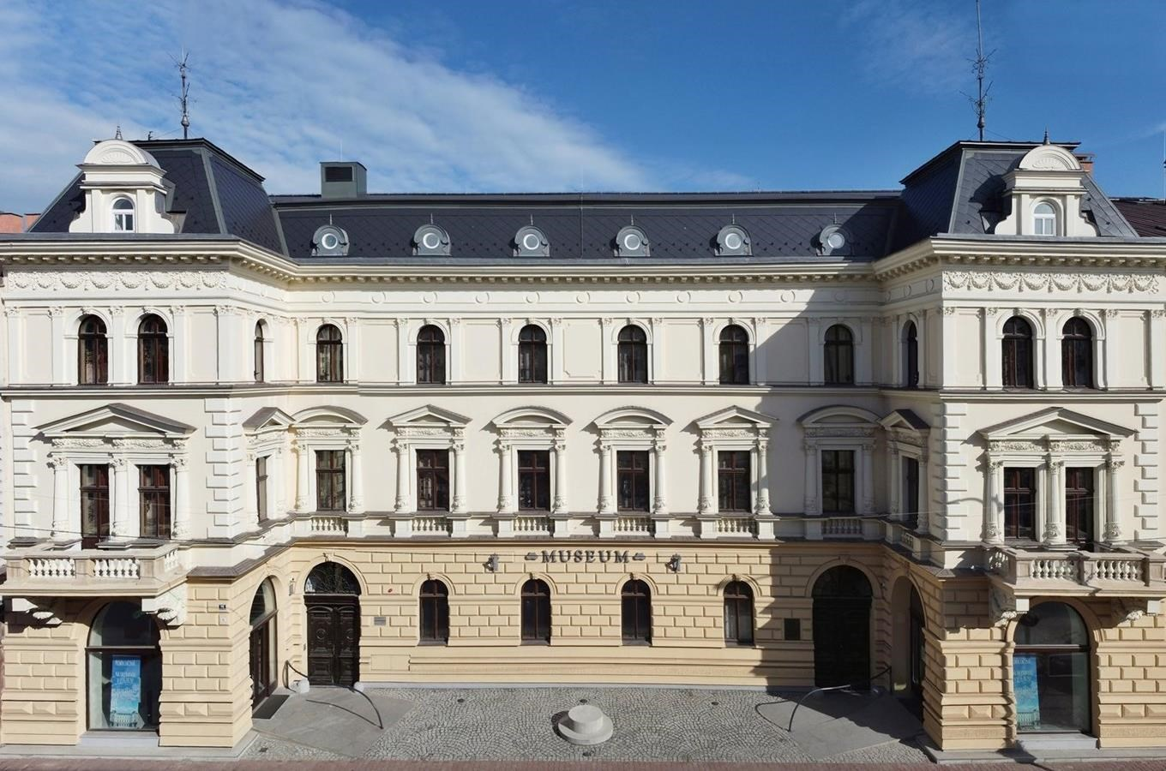
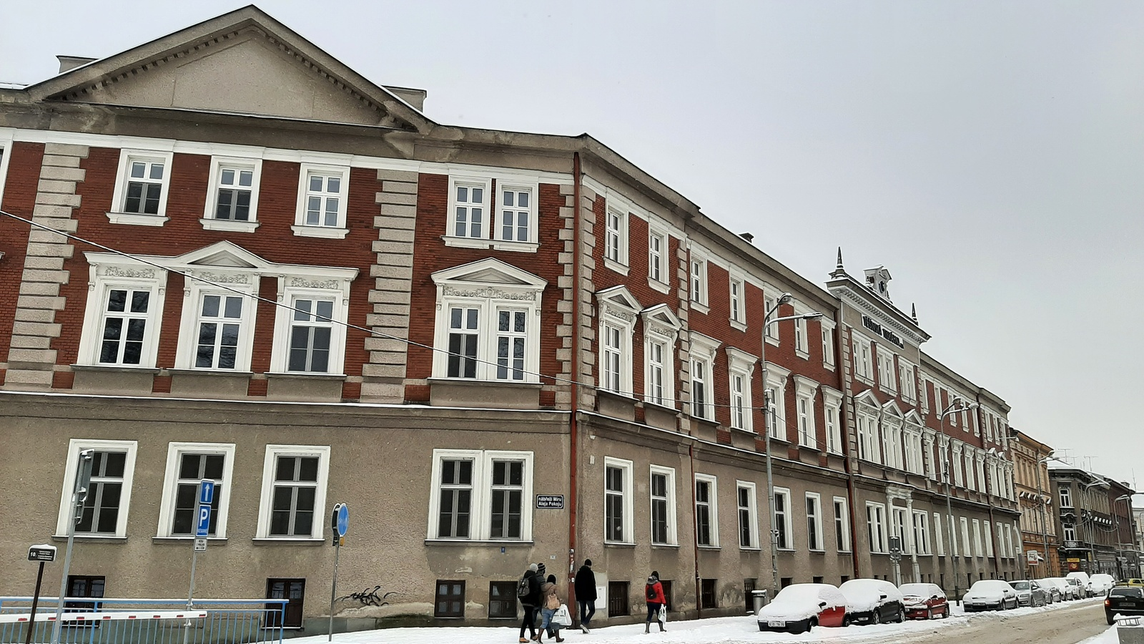
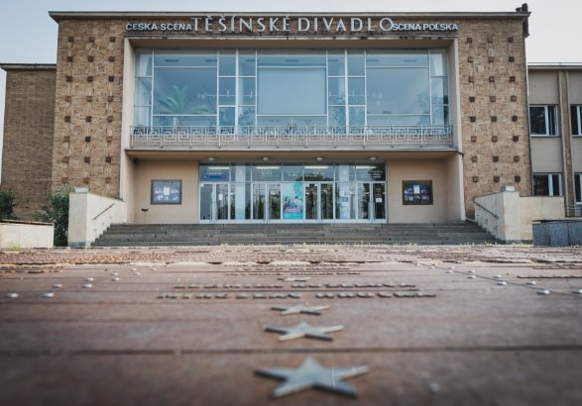
Interesting places
Muzeum
Printing house
Theatre

Slide 5
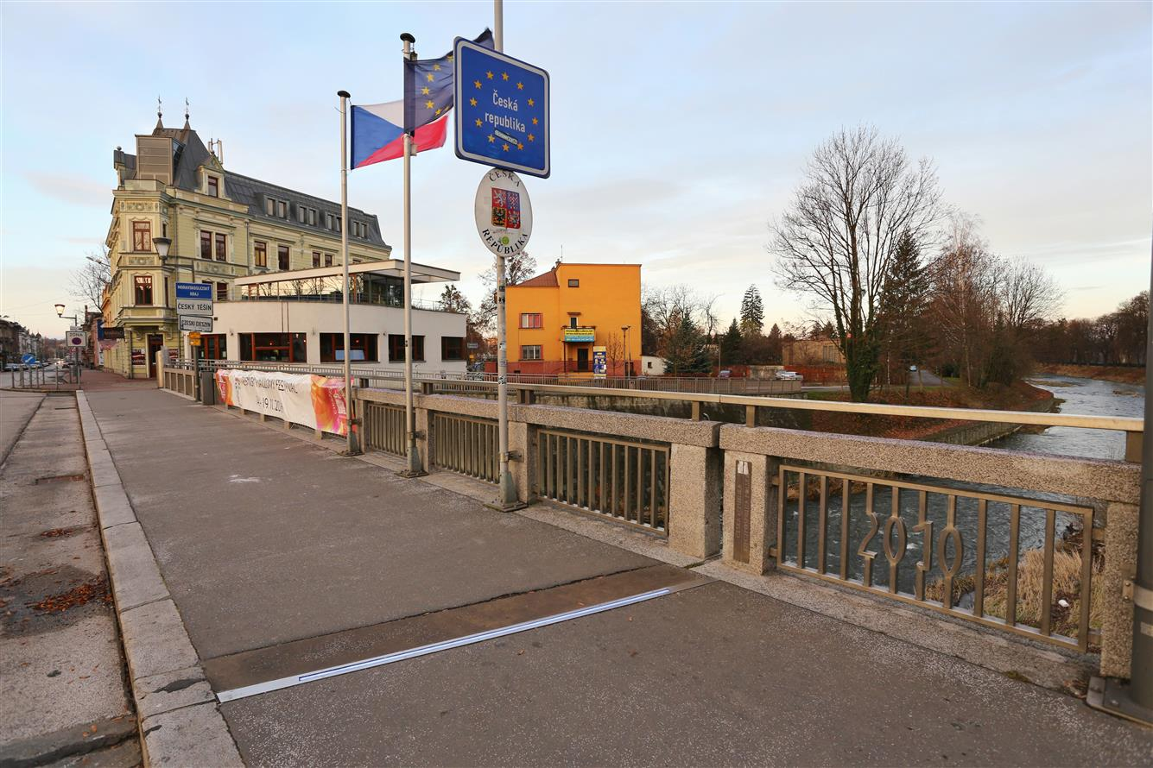
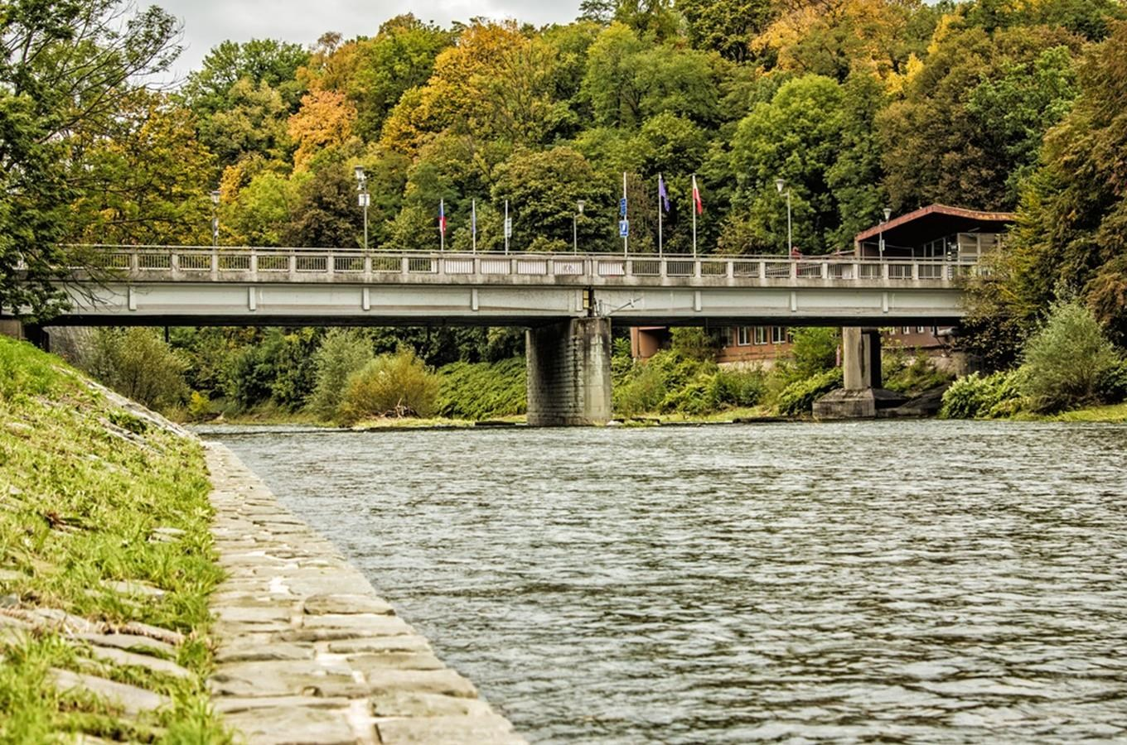
Border with Poland

Slide 6
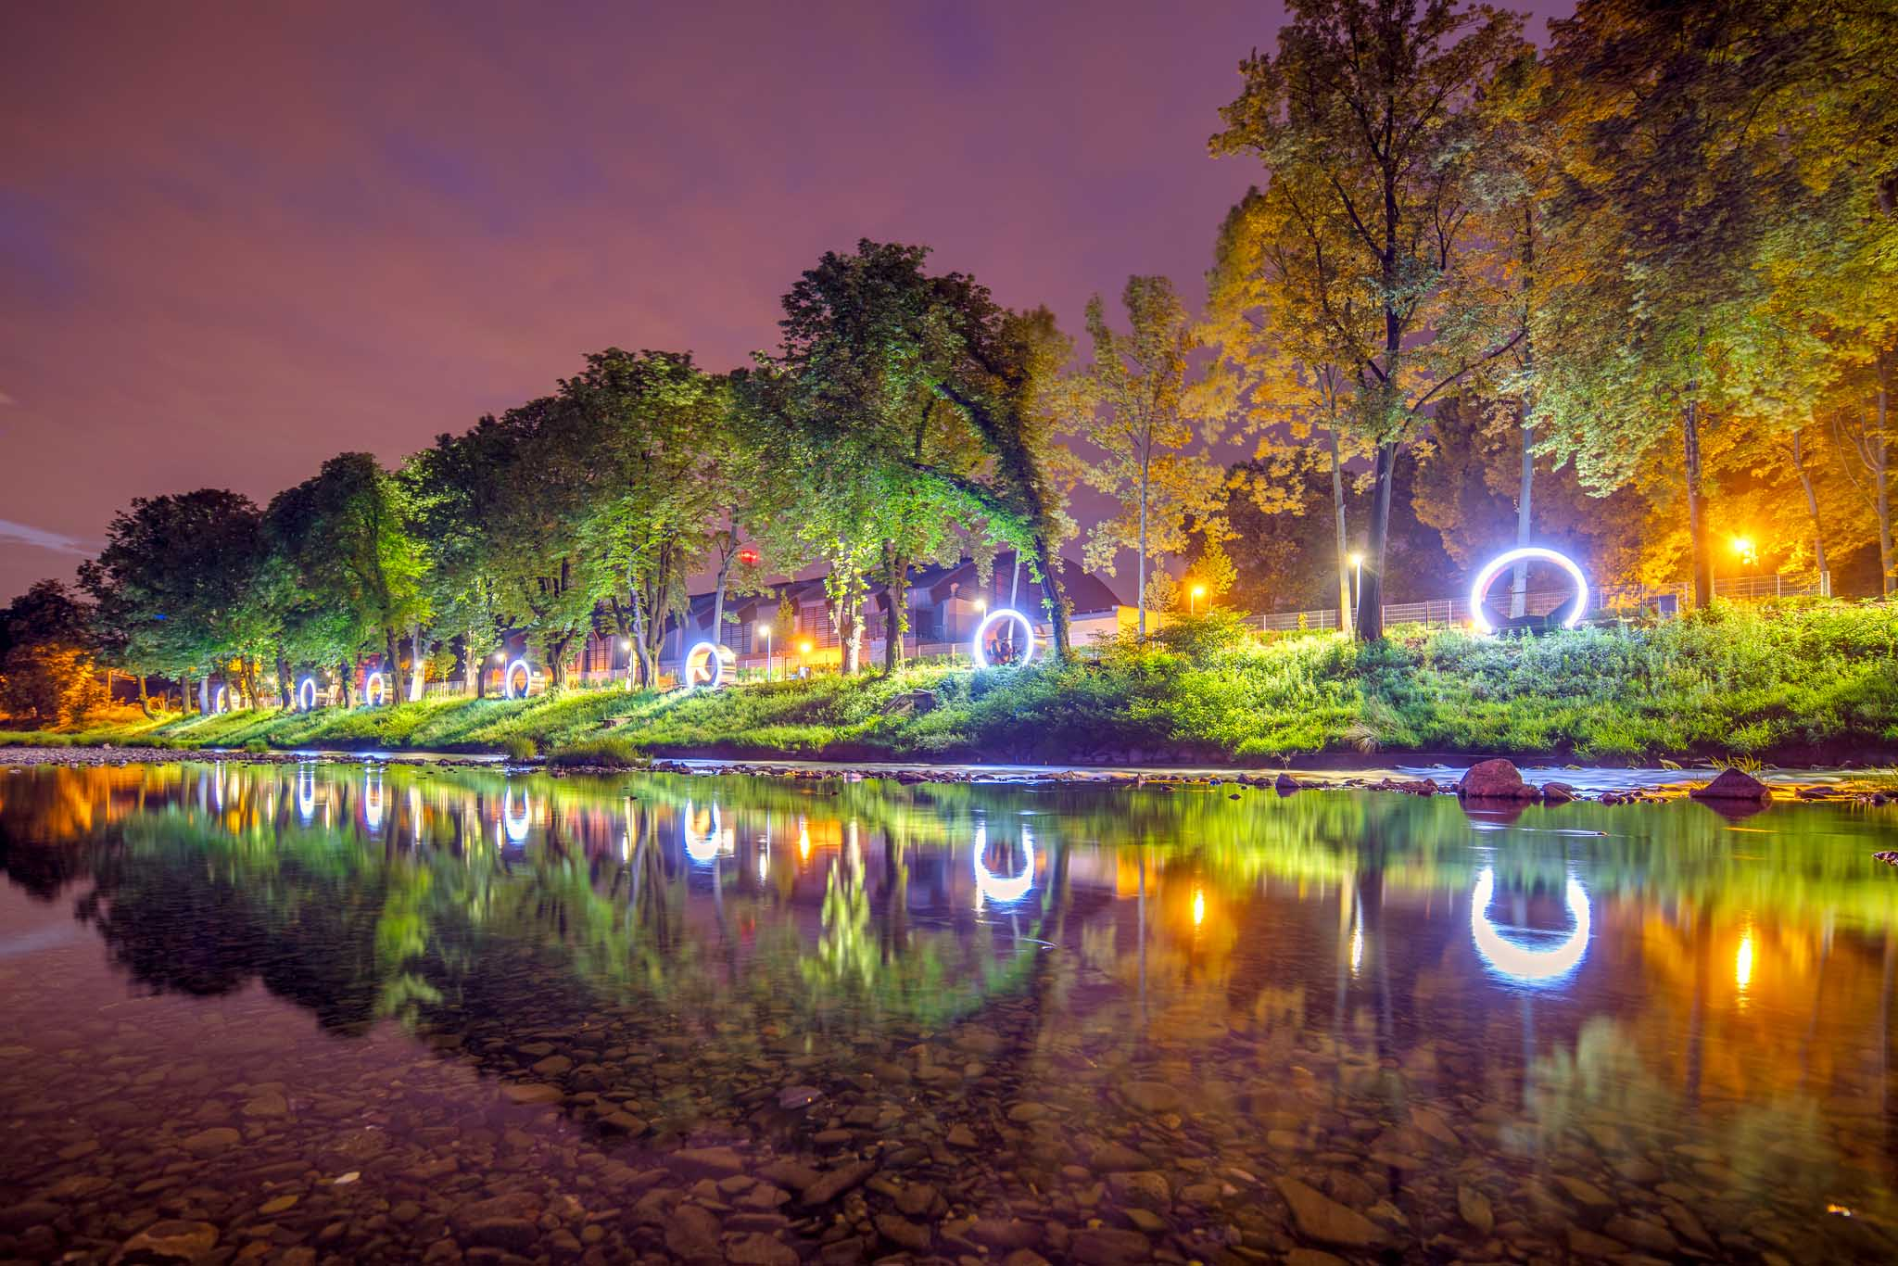
Cieszyn
Zofia Jasiok

Slide 7
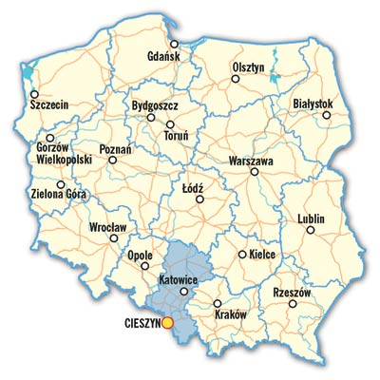
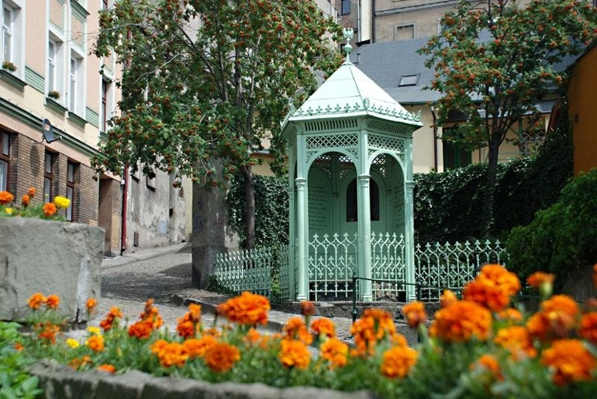
Geography and History
Cieszyn is a border town in southern Poland on the east bank of the Olza River.
The medieval town plan has survived in Cieszyn, and many architectural treasures and charming places have survived. The town’s unique atmosphere was created by generations of its citizens of various nationalities, religions, cultures and traditions.
The town has 33,500 inhabitants.
Cieszyn is one of the oldest cities in Silesia.
The legend says that it was founded in 810 by three sons of the Prince Leszek III: Bolko, Leszko and Cieszko.
According to legend while rejoicing (in Polish: “cieszyli się”) over their reunion at the spring, they founded a town and gave it the name of Cieszyn. In the place of the legendary meeting there is a well called The Well of The Three Brothers.
The Well of Three Brothers

Slide 8
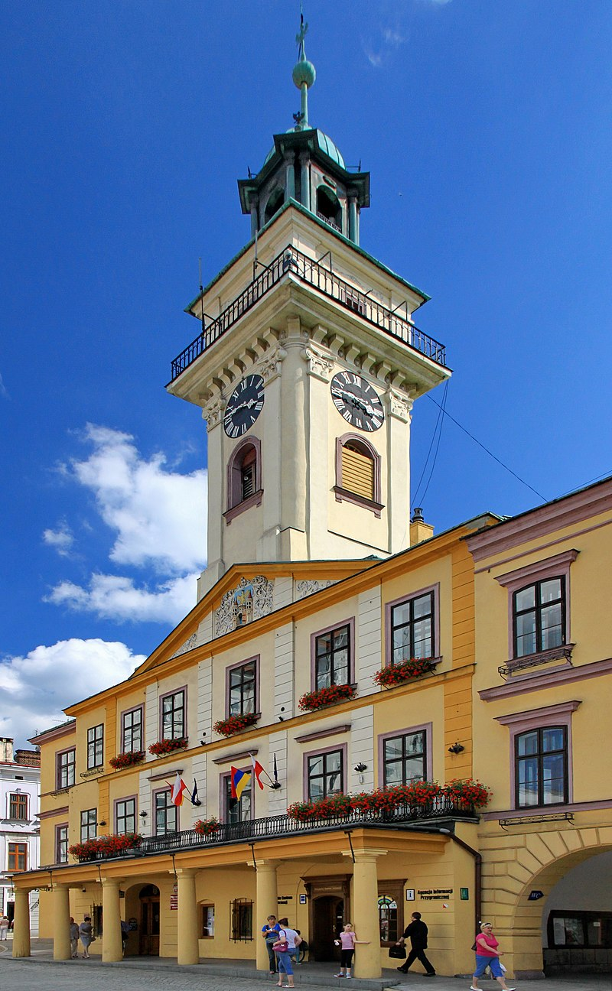
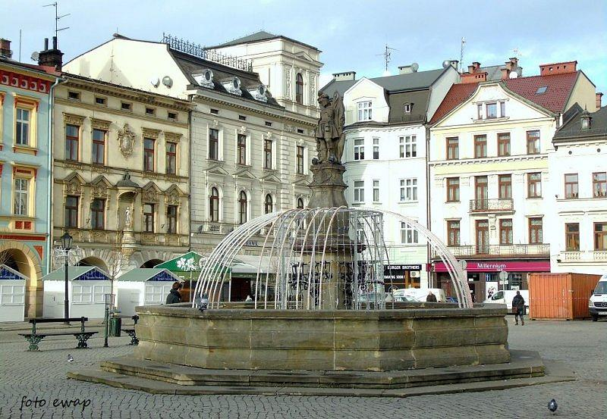
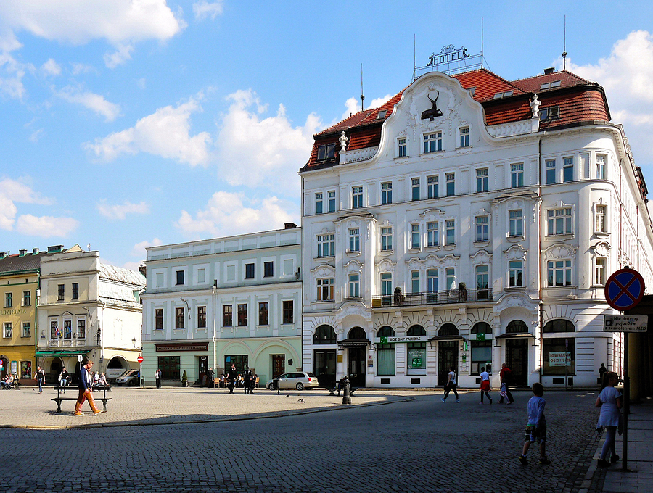
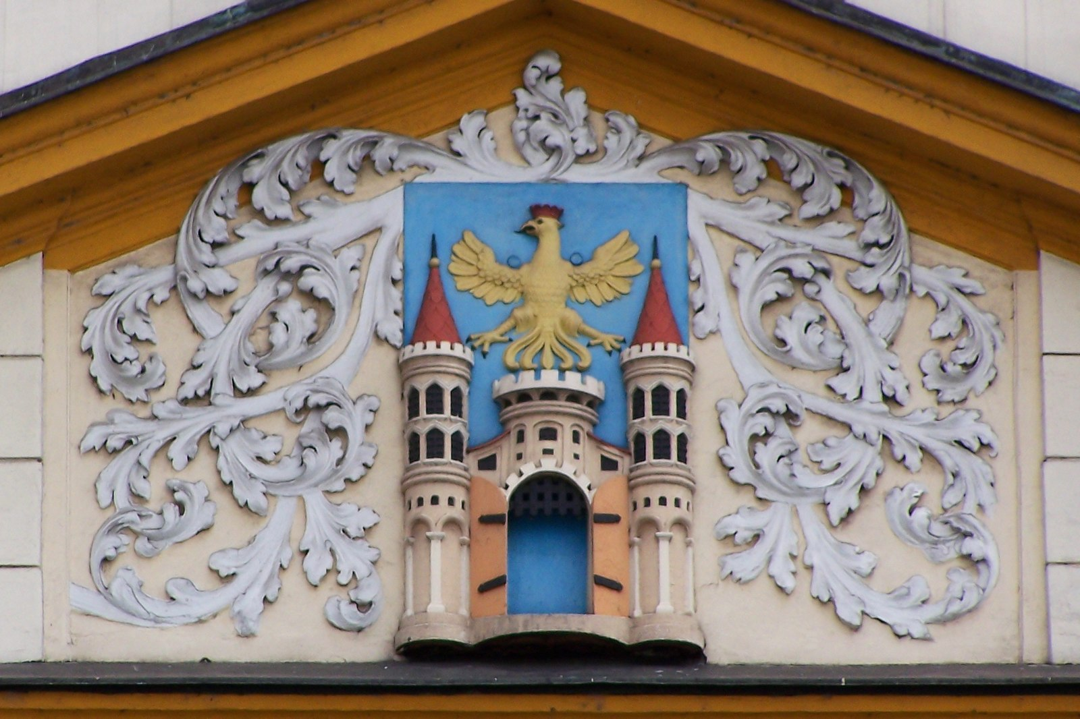
The Old Town Square
The town square was laid down in this place at the end of the 15th century. After the great fire of 1789 the houses were rebuilt in Baroque - neoclassicist style.
The Town Hall The existing Town Hall was built in 1496. After several fires it was restored in as a classicist building by the Viennese architect.
The fountain with a figure of St. Florian
In the centre of the Town Square there is a well with a statue of St. Florian. The well formed a part of the town’s medieval water supply.
Hotel "Pod Brunatnym Jeleniem" The most illustrious guests were Tsars Paul I and Alexander, Austrian Emperors: Joseph II and Ferdinand. The current building was put up at the beginning of the 20th century in keeping with the most modern Viennese fashions.
The Coat of arms of Cieszyn on the pediment of the town hall.

Slide 9
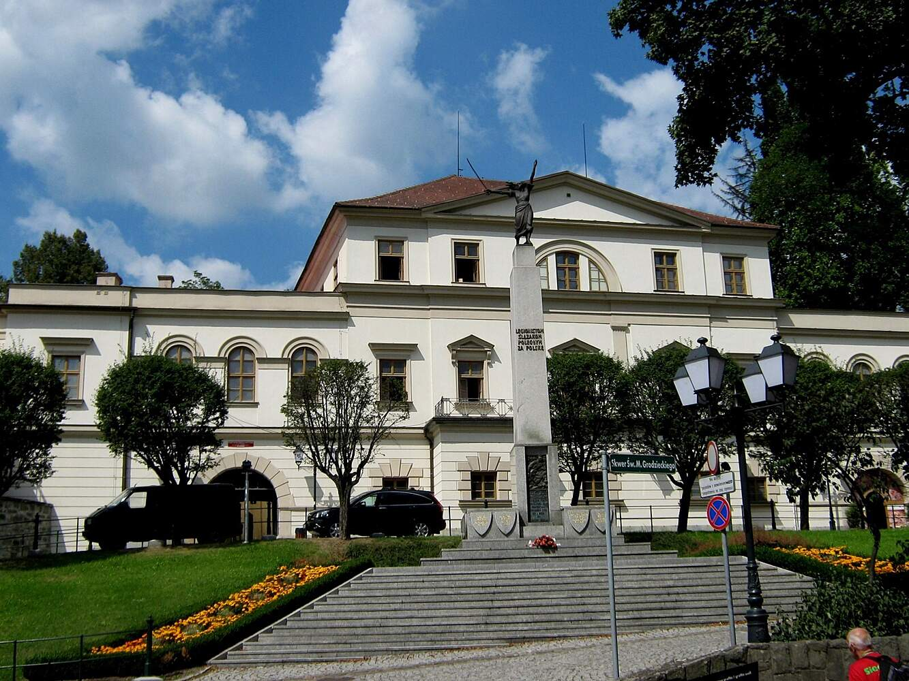
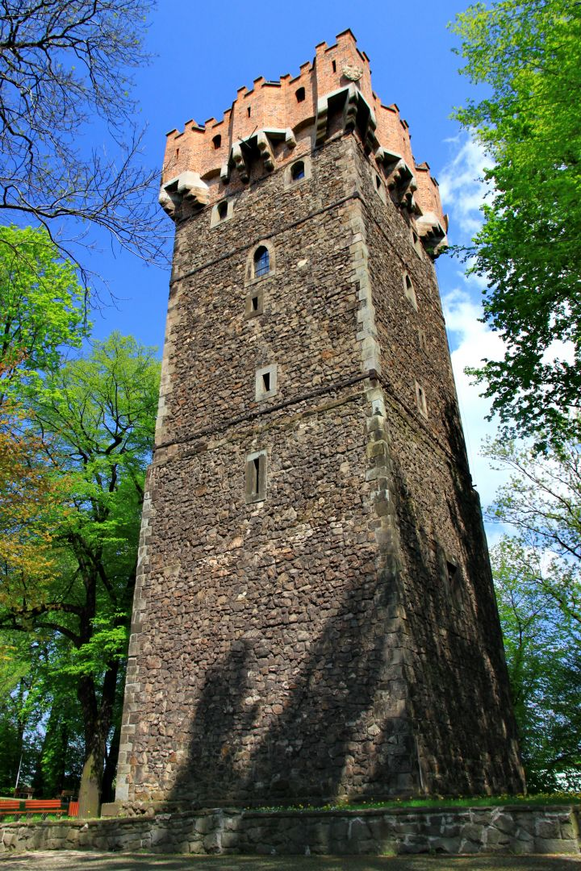
The Castle Hill
The first evidence of settlement on Castle Hill comes from the 5th century BC. Around 990 the hill fort was incorporated into the Polish Piast state.
The 14th-century Piast Tower One of the Gothic castle’s towers, it was an important element of the defence system. At 29 m tall it is a marvellous viewpoint on the town and the Silesian Beskid and Silesian-Moravian mountains. The underground part was once a dungeon. The highest part of the Piast Tower had military functions.
The Habsburg palace was built in 1840.
The previous old castle was destroyed during the Thirty Years’ War (1618-48) and later it was rebuilt in neoclassicist style according to the plans of the Viennese architect.

Slide 10
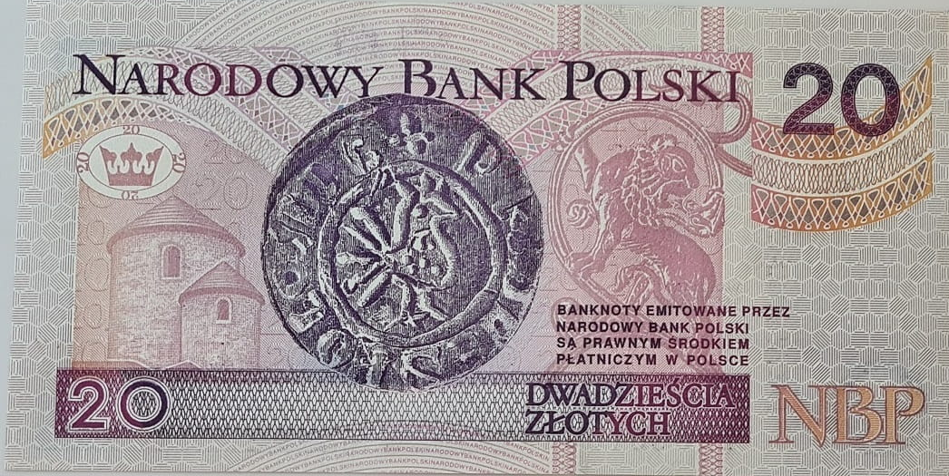
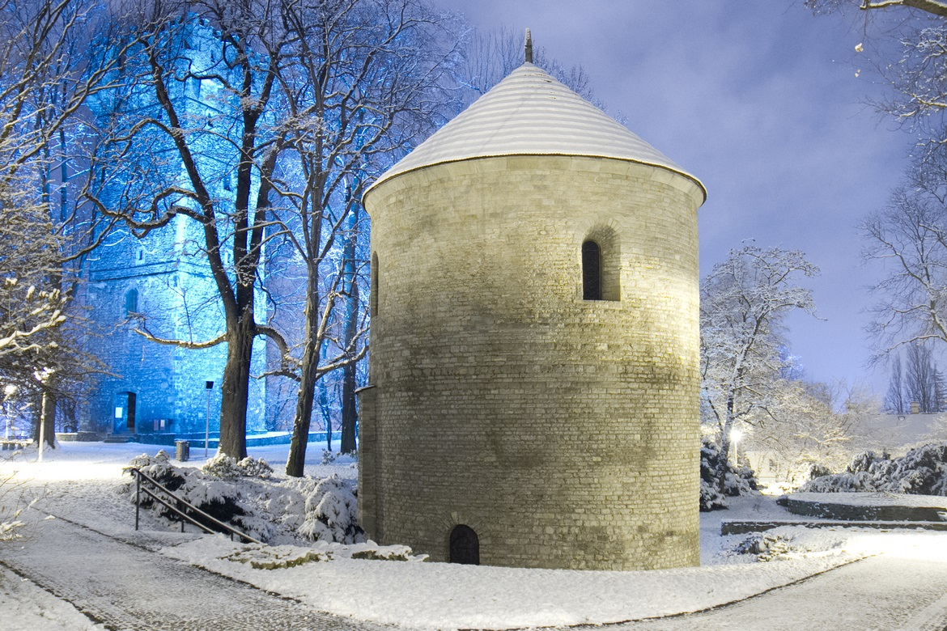
The Castle Hill
The Rotunda of St. Nicholas One of the oldest Christian churches in Poland and the most valuable architectural treasure in Silesia; it features on the 20-złoty banknote. Probably built in the 11th century, it is one of the best preserved treasures of Romanesque art in Poland.
Initially the rotunda fulfilled the role of the castle chapel, also serving the people living beyond the castle walls.

